Slide 1
Packages
Python Coding Workshop
23.03.2026

Slide 2



Functions
... a resuable block of code that performs a specific task.
Analogy: Coffee Machine
Has functions for different types of coffee
Performs the same task for each type of coffee
Analogy: Alien
Alf knows all the steps to get a coffee
You just have to ask him (call upon him)

Slide 3
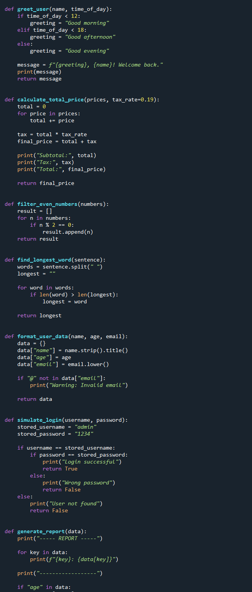
Packages
Code can get messy, when you have a lot of functions
Packages are collections of functions
One script – a lot functions
Harder to reuse
Another script – another bunch of functions?
You can write your own packages or use packages from the open source community

Slide 4
Exercise 1: Build your own package
Open a new python file
Add a function to add two numbers
Save it as “my_package.py”
Open a new python file
Add at first “import my_package”
Type “my_package.”
Describe what happens
Extend your package my another function

Slide 5
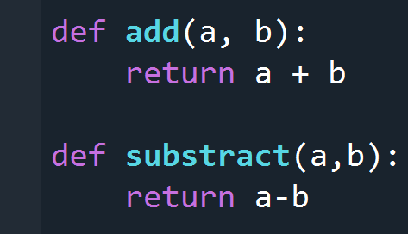
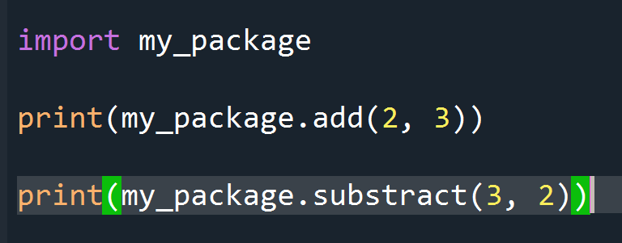
Your Package
Your script

Slide 6
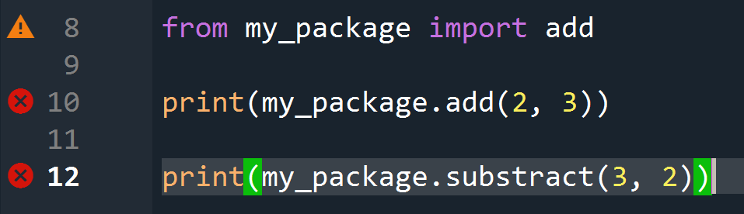
Import single functions
It can be useful to only import single functions
Some packages are pretty large and will decrease your performance, when they are fully imported

Slide 7
Import single functions
It can be useful to only import single functions
Some packages are pretty large and will decrease your performance, when they are fully imported
Unused package
Undefined function
Undefined function (and not imported)

Slide 8
Exercise II: Correct the shown code
It can be useful to only import single functions
Some packages are pretty large and will decrease your performance, when they are fully imported
Unused package
Undefined function
Undefined function (and not imported)

Slide 9
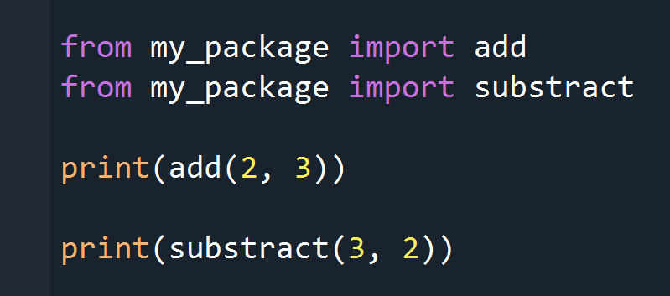
Solution
No need to call the package, when you imported single functions
Packages are similar to folders
If you import a full package, you have to write “package.function”
If you import single functions, the name of the function is enough to call

Slide 10
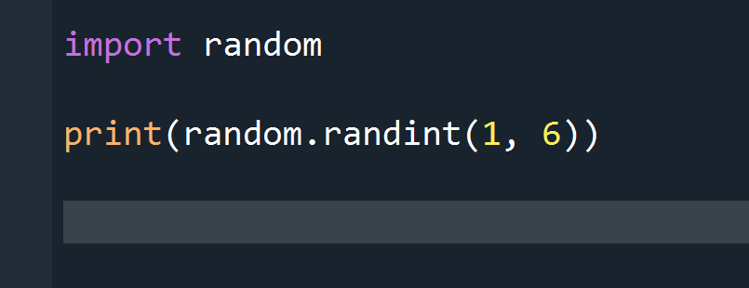
Exercise III
Create a package for different dices
You can import packages into your package
Create a function for a 6-sided, 8-sided and 20-sided dice
Depending on the outcome, write if-statements for specific outputs for certain values (“You hit a 20! That’s awesome!”)
In your mainscript: Write a for-loop to roll the dice a lot of times

Slide 11
Important Packages
Hitchikers guide to scientific programming

Slide 12
The numpy route

Slide 13
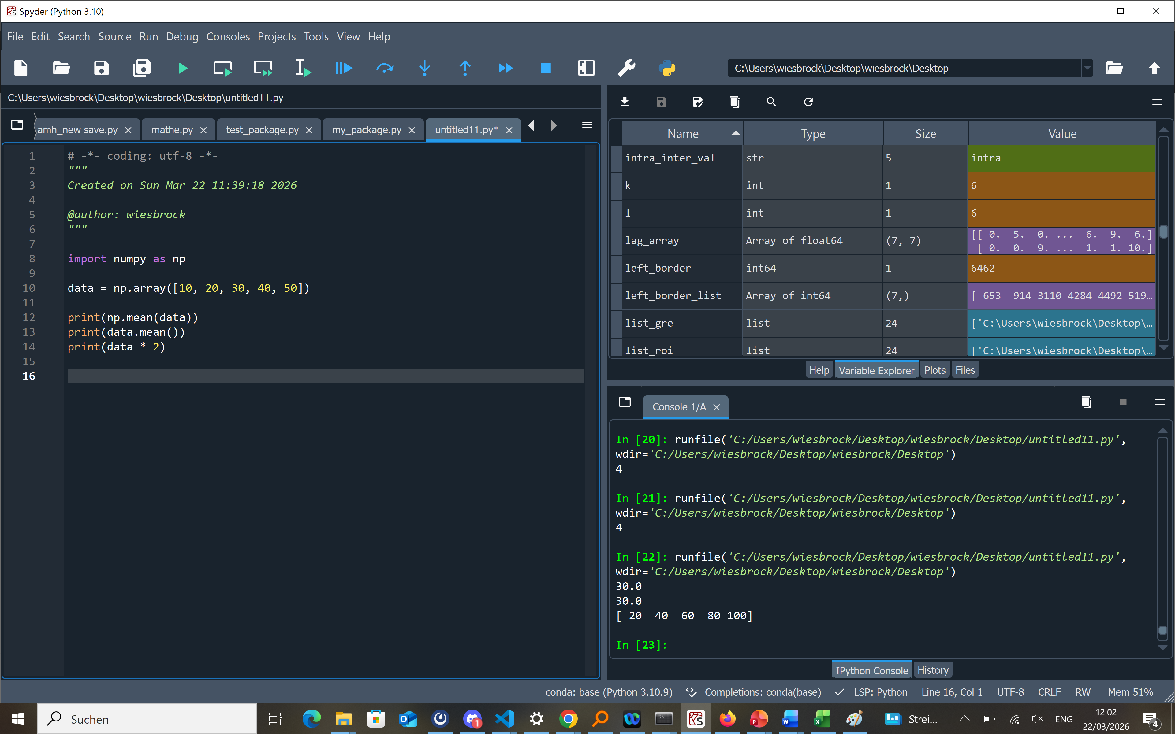
Numpy
Work with numerical data (arrays)
Fast operations on many values at once
Foundation for scientific computing
Feels more “mathematical” than normal Python lists
Output

Slide 14
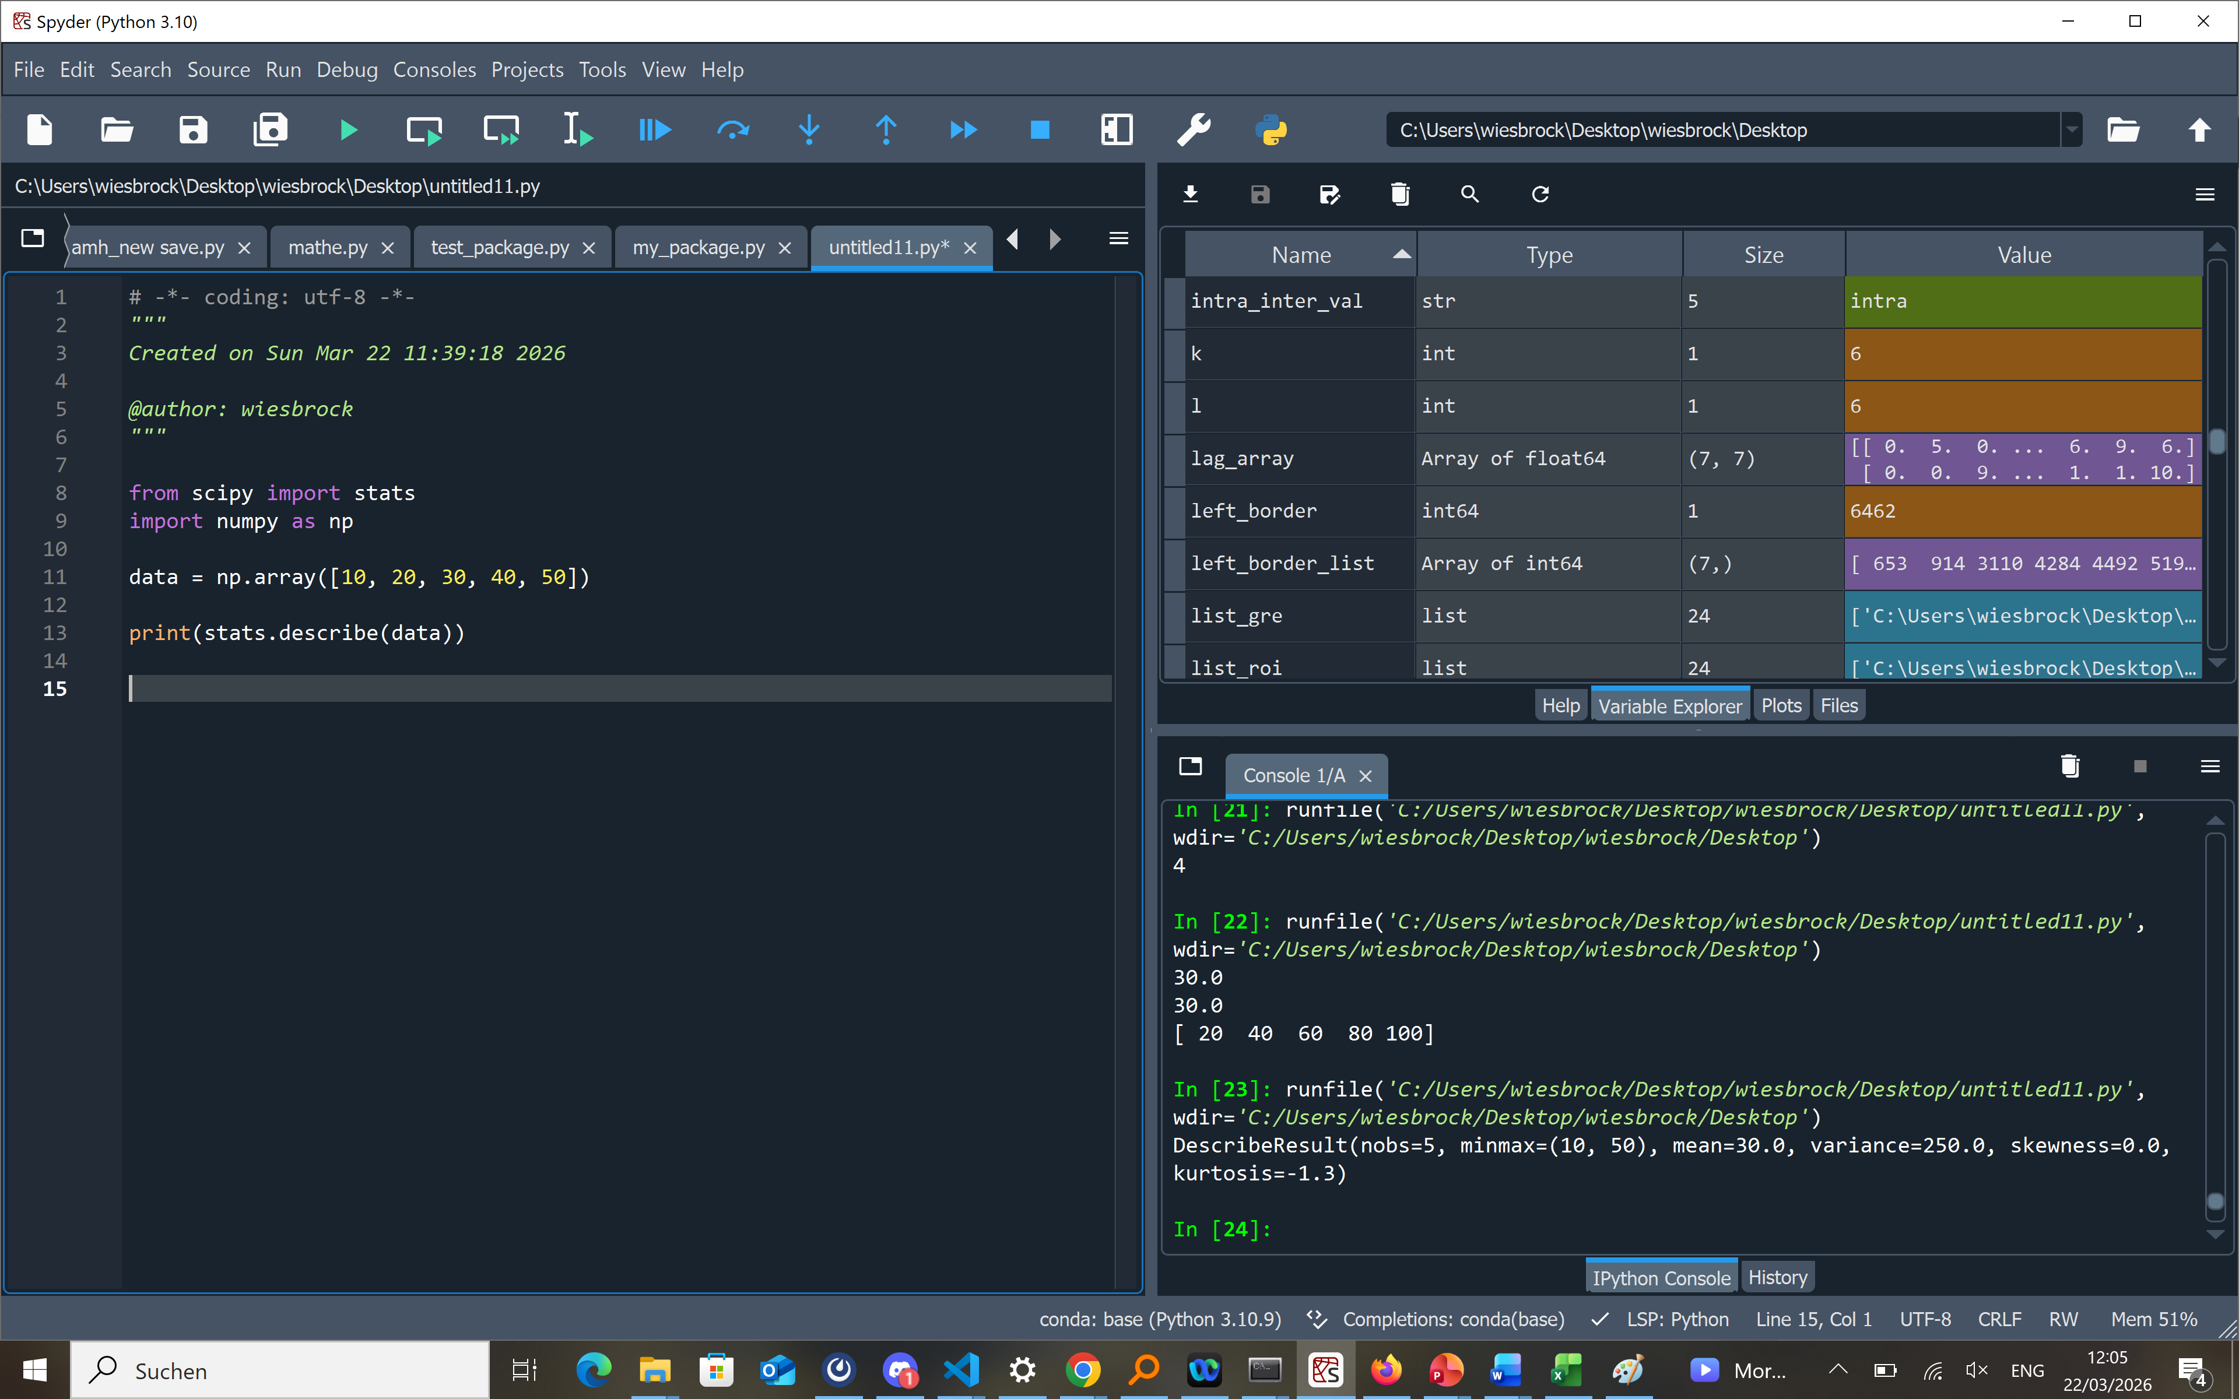
Scipy
Advanced math and statistics functions
Built on top of NumPy
Includes optimization, distributions, tests
More powerful, but more complex
Output

Slide 15
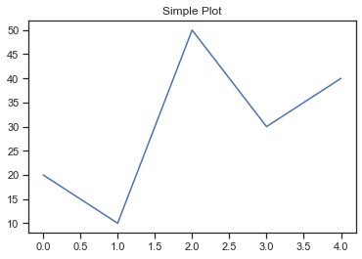
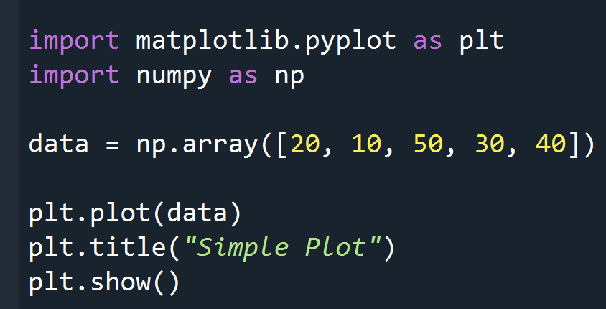
Matplotlib (see Module 10)
Create plots and charts (line, bar, etc.)
Very flexible and customizable
Works well with NumPy data
More control, but more code

Slide 16
The pandas route

Slide 17
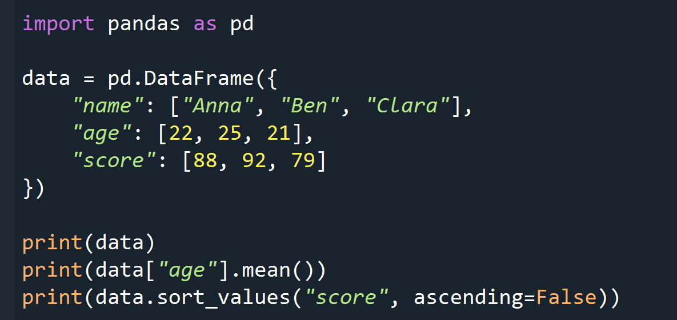

Pandas
Work with tables (DataFrames)
Like Excel, but in Python
Easy data analysis (filter, sort, group)
Great for real-world datasets (CSV, etc.)

Slide 18
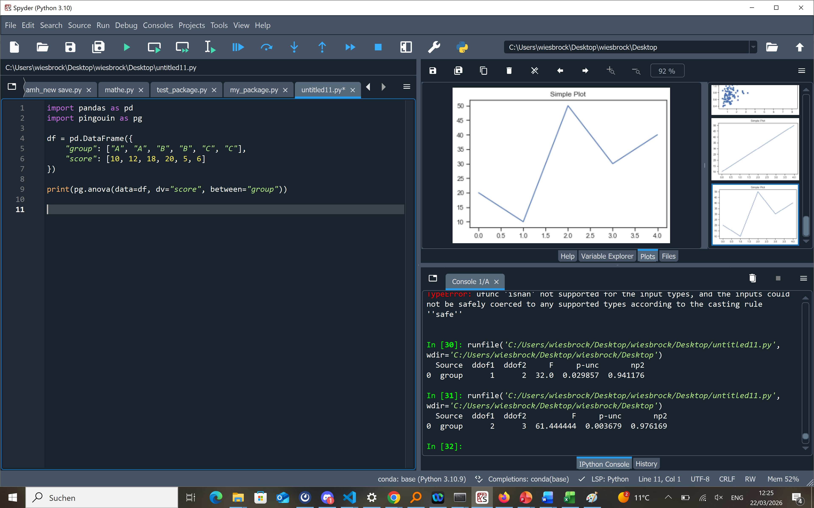
Pingouin
Simple statistical analysis
Works with pandas DataFrames
Includes tests like t-test, ANOVA, correlations
Easy to use, but requires some statistics understanding

Slide 19
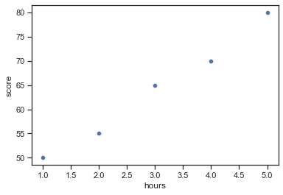

Seaborn
High-level data visualization
Built on Matplotlib
Works directly with pandas DataFrames
Less code, nicer default plots

Slide 20
Take Home
Packages are your strongest allies in being time efficient
To unleash their full potential, it is mandatory to know how to read documentations (see the next module)
For every task, you should ask yourself: Is there a package for that?
Packages have different learning curves
As a starter, it is recommended to chose one route and stick to that in the first place. Over time you will learn both routes anyway.

